Slide 1


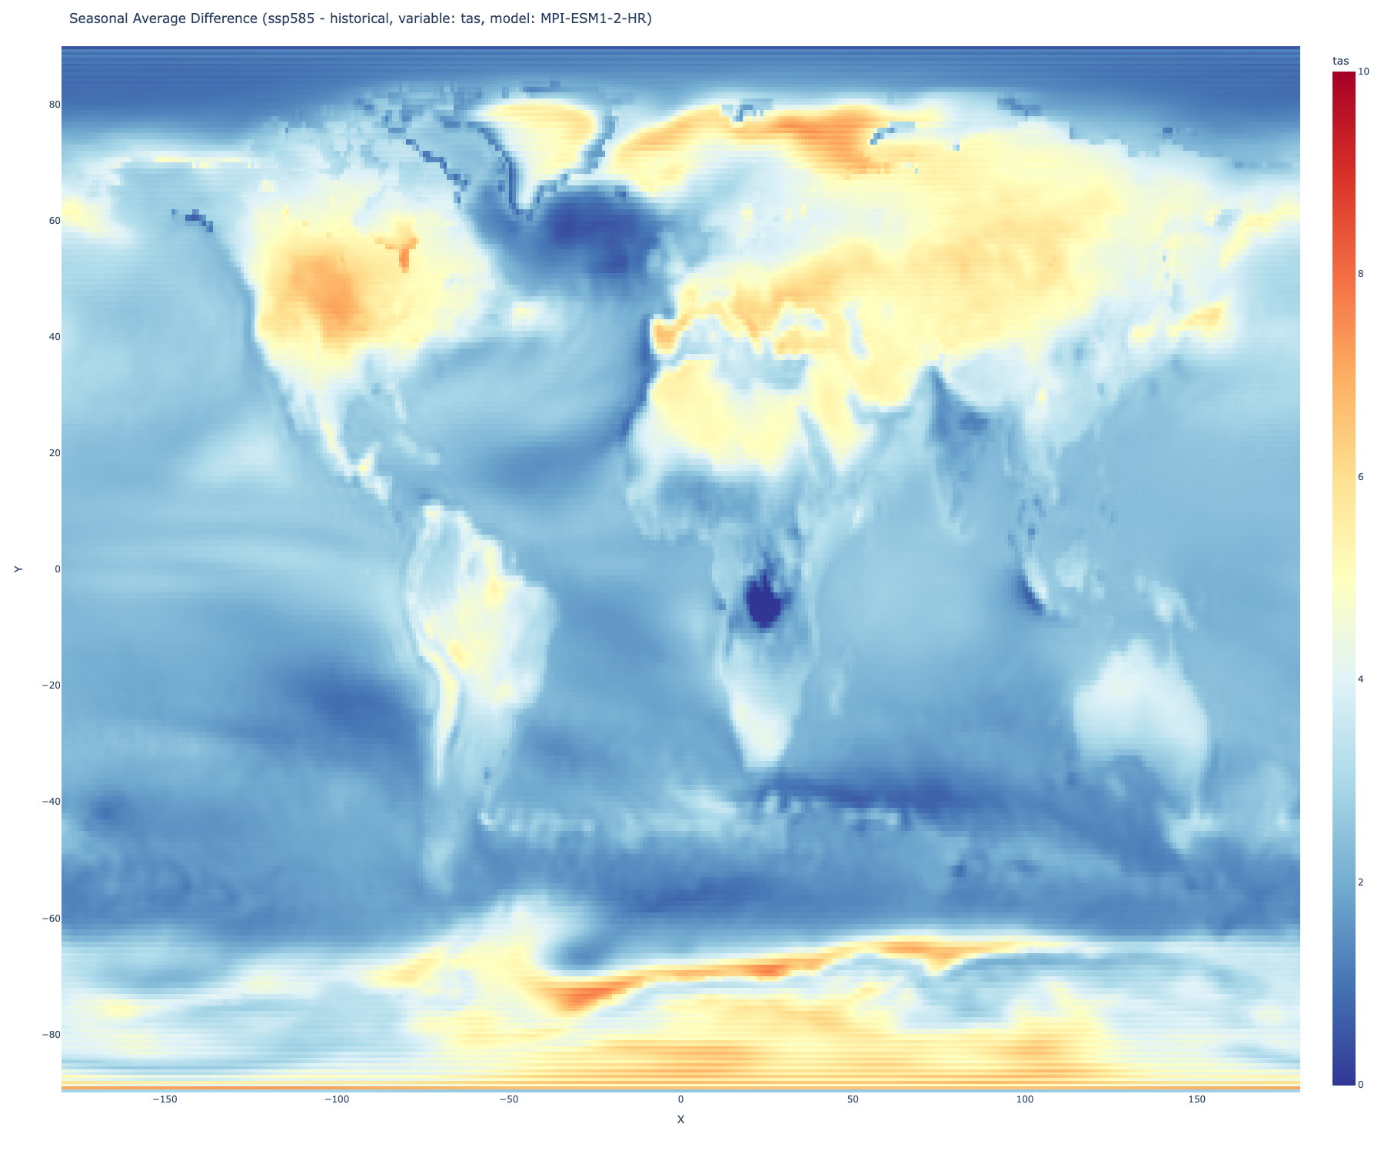
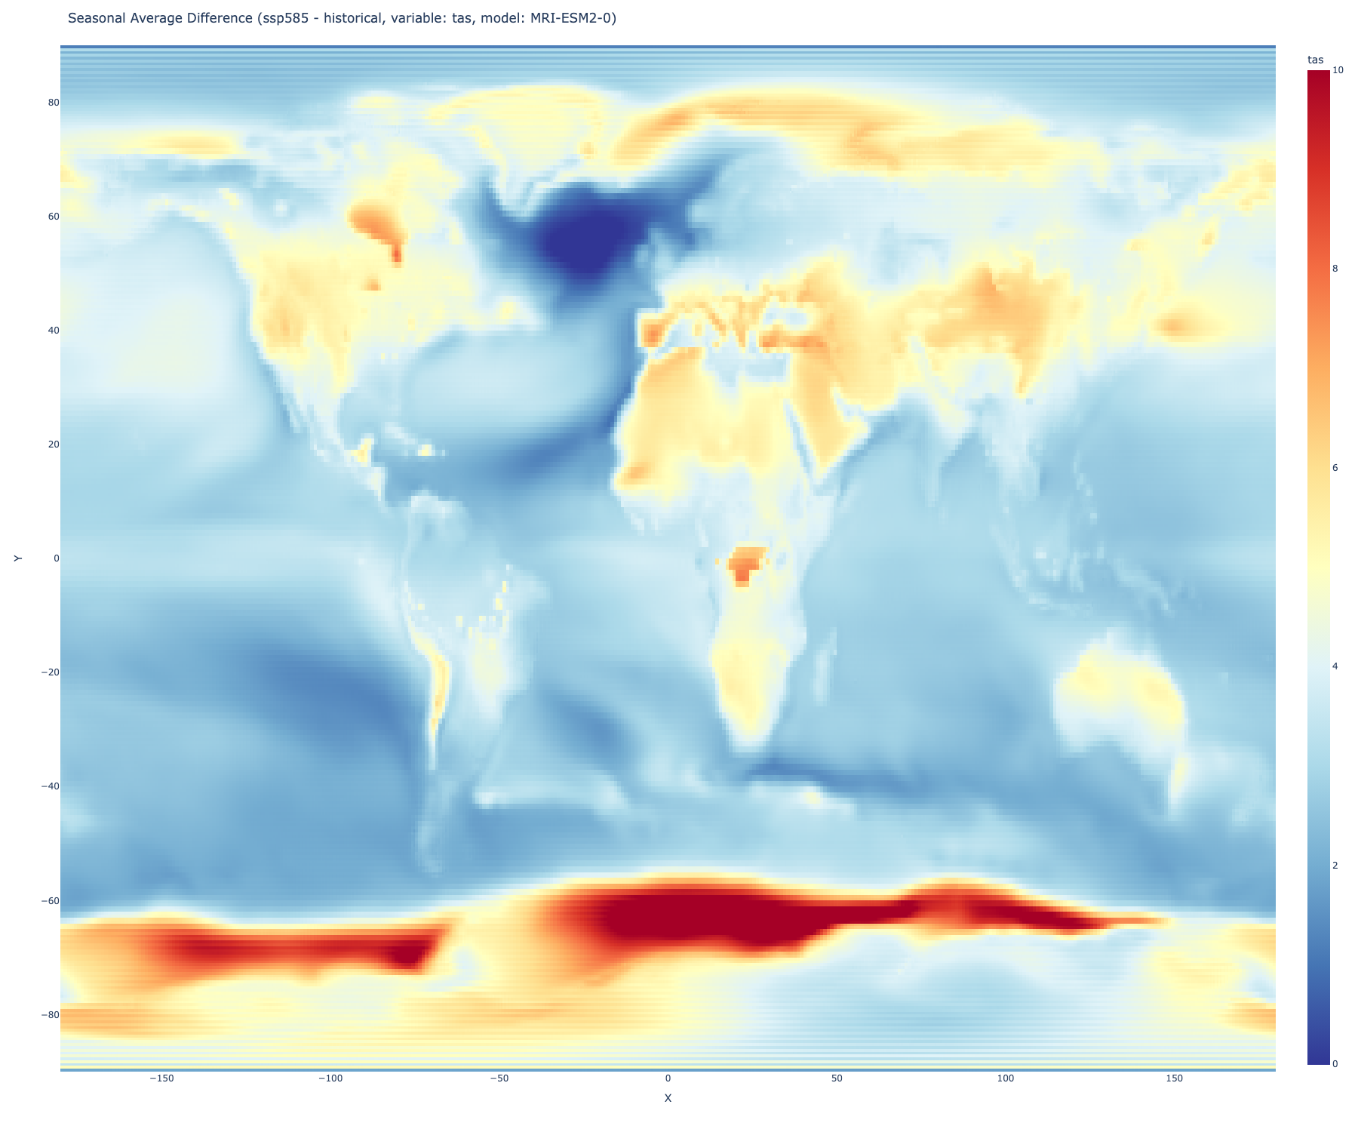
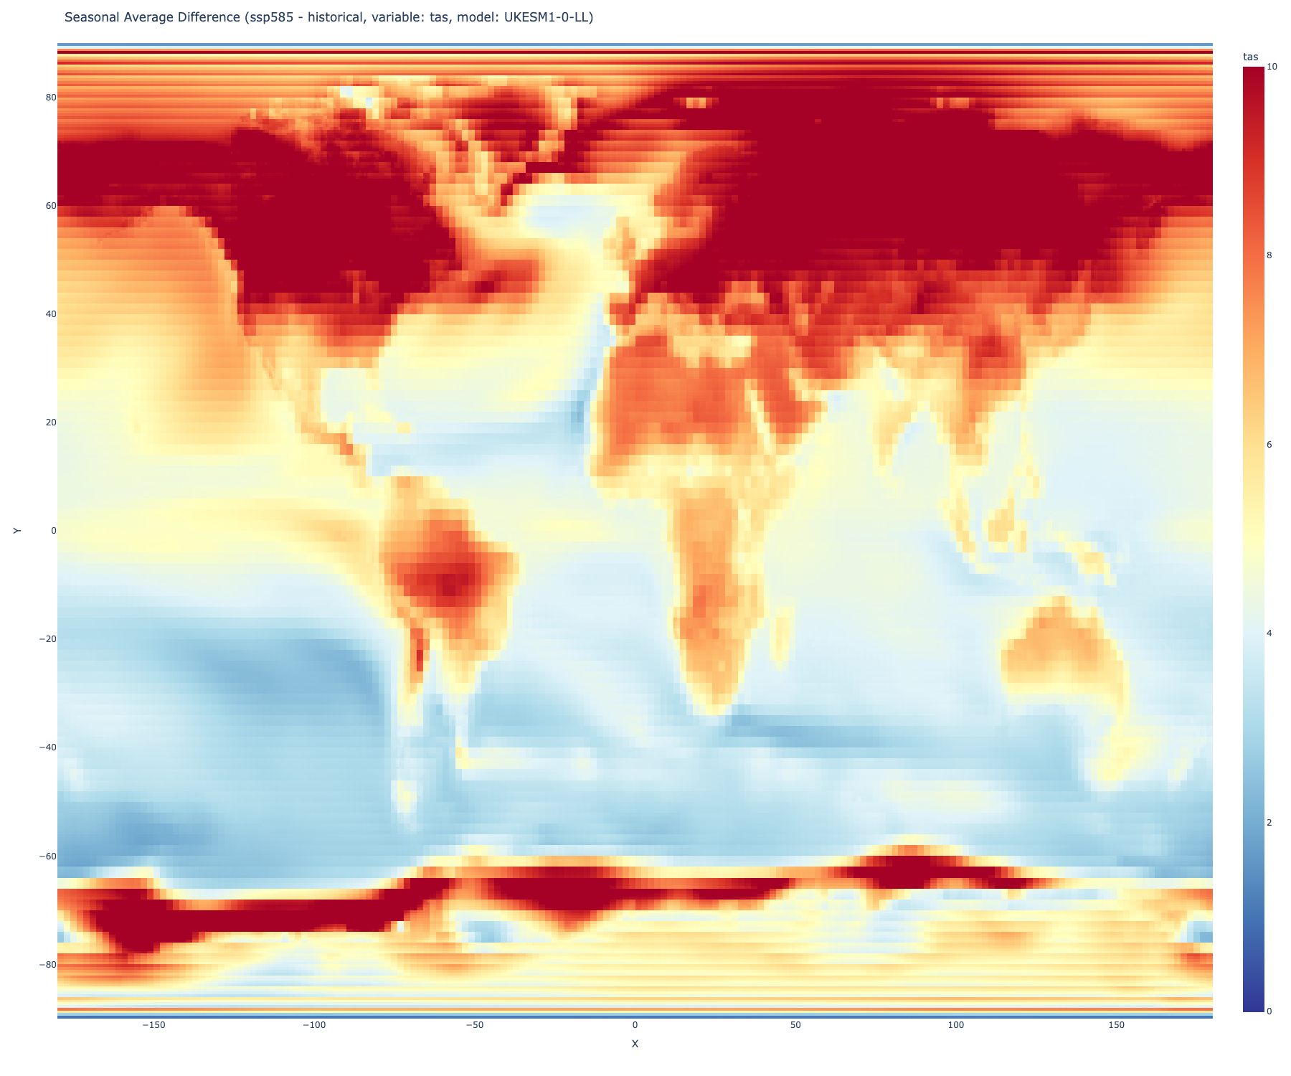
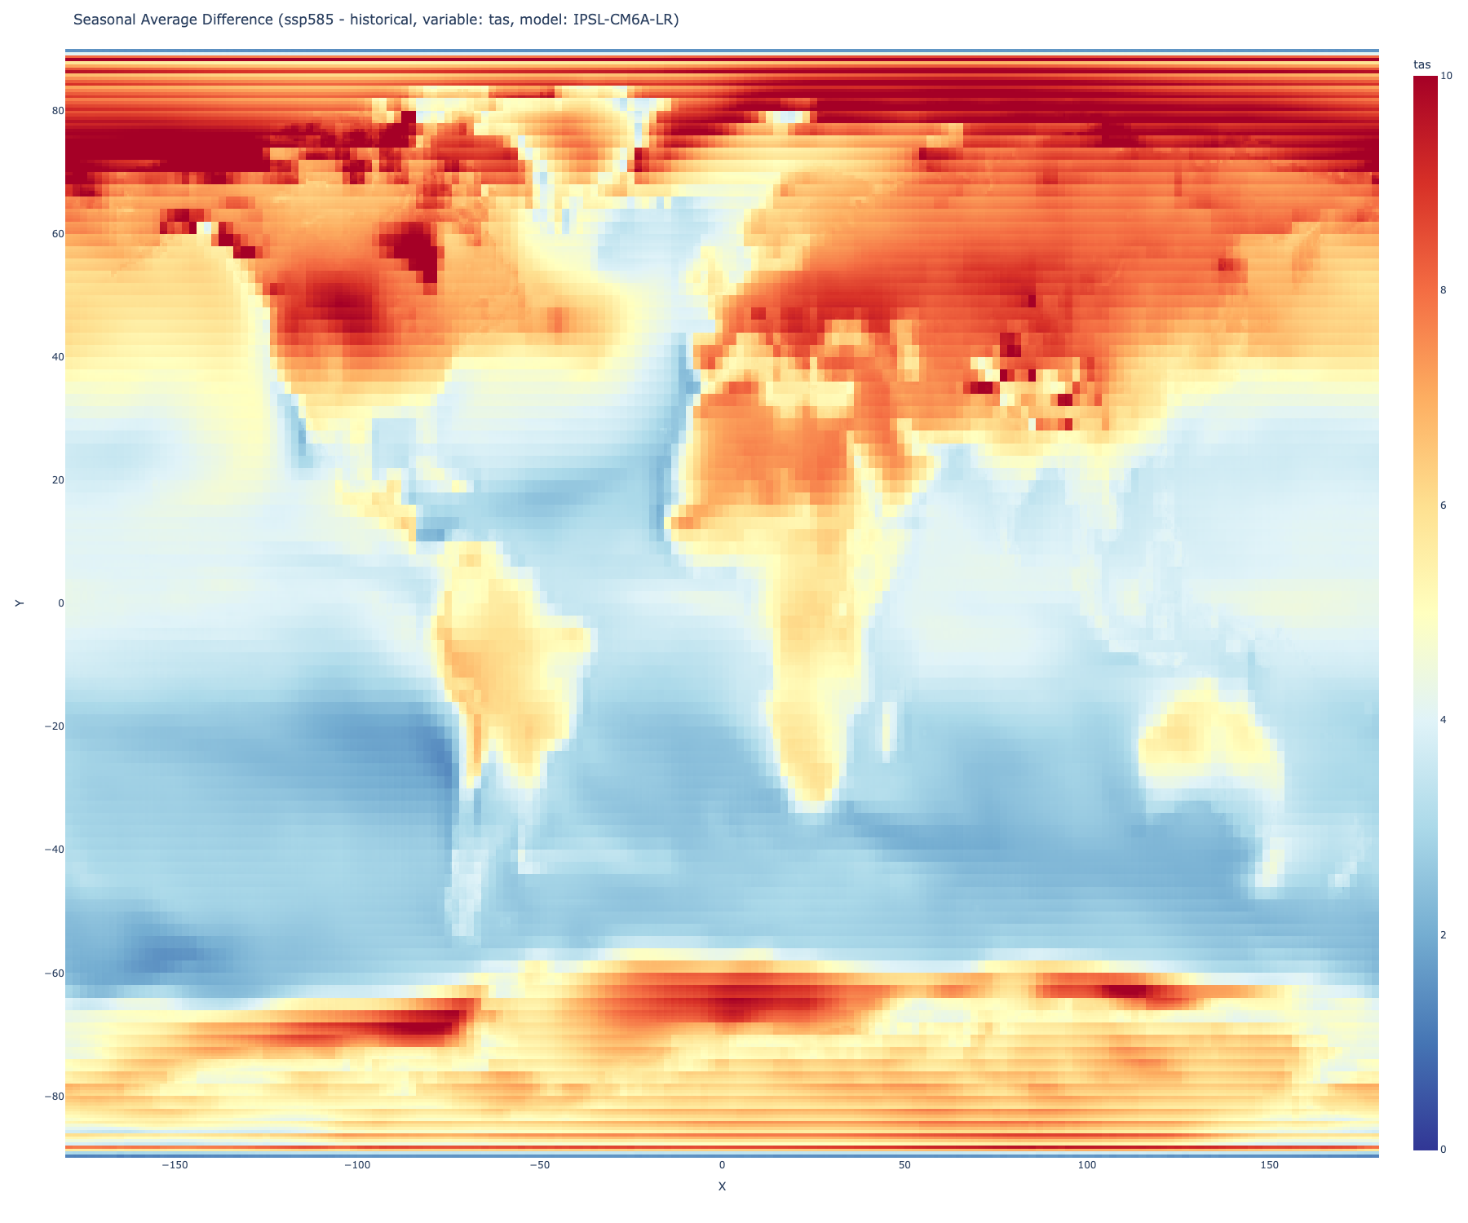

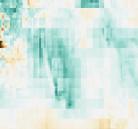
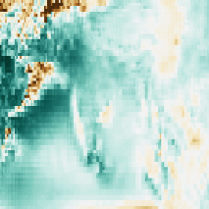
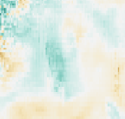
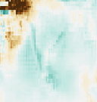
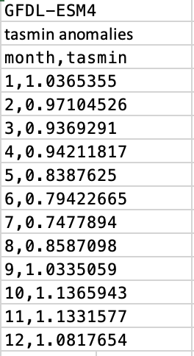
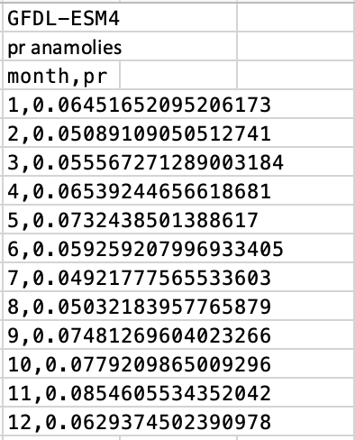


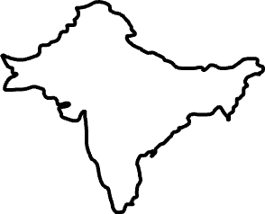


Background
Bias-Corrected Climate Change Projections for South Asia, South America, and Thailand-Vietnam
Sheen Zutshi¹, Azhar Ehsan², Remi Cousin³
Background
Seasonal Projection maps: JJA; historical (1981-2014) vs future (2070—2099), tas (mean temp)
Reliable climate projections assist policy makers and businesses in making informed decisions about the impact of climate change on society and business practices, enabling effective resource allocation for the future. By quantifying and visualizing our future climate, we can more easily inform and educate non-science persons about our future in hopes of productive change. This study employs bias-corrected climate change projection data derived from the Inter-Sectoral Impact Model Intercomparison Project (ISIMIP) that are based on Coupled Model Intercomparison Project phase 6 (CMIP6) models. Five models namely GFDL-ESM4, IPSL-CM6A-LR, MPI-ESM1-2-HR, MRI-ESM2-0, and UKESM1-0-LL were used in conjunction with 3 future warming scenarios–SSP585, SSP370, and SSP126. The regions of interest are South Asia, South America, and Thailand-Vietnam, and variables of interest are minimum temperature, maximum temperature, mean temperature, solar radiation, and precipitation. The projected changes between future periods and the historical simulation (1981-2014) are calculated to show climate change in these specific regions. In particular, the goal was to build an interactive visualization tool that illustrates change in these five variables based on a user’s selection of a specific time period, warming scenario, model, and region.
MPI-ESM1-2-HR
MRI-ESM2-0
UKESM1-0-LL
ISPL-CM6A-LR
Methodology
Seasonal Projection maps: JJA; historical (1981-2014) vs future (2070—2099), pr (precipitation)
UKESM1-0-LL
ISPL-CM6A-LR
Initial methods included creating comparison code to affirm the conversion from netCDF files to zarr files was correct. The CMIP6 data was stored as zarr files so they resided on the cloud for faster processing time and easier access.
I created functions that created monthly averages, monthly annual averages, seasonal annual averages, and most importantly, future minus historical seasonal annual averages. These were stored in xarray format. On top of these computational functions, I also created mapping functions that called these functions and printed maps using plotly. The functions had inputs of variable, scenario, month/season, and model. I utilized Python Xarray for all of this code and worked in VSCode.
With the use of some of my code, existing code, and new code, Remi created an app/tool in IRI’s Maprooms. I helped with the UI of the app.
MPI-ESM1-2-HR
GFDL-ESM4
MRI-ESM2-0
Difference between Future-Historical. Monthly Annual Averages for model GFDL-ESM4, variables tasmin & pr.
Conclusions
Acknowledgements
Annual Seasonal difference maps are able to be computed based on a user’s input of variable, model, scenario, season, and time period. These initial computations are the building blocks for future work. PepsiCo’s instructions necessitate a tool/app that given a user’s input, will give a map. I am contributing to the seasonal projections of this tool, but future work by others involves sub seasonal and seasonal projections as well as other attributes such as determining the number of dry and wet days in a given season. While this project is ongoing, we were able to conclude that our zarr conversion was successful and our functions outputted correct data in the form of maps.
I want to thank Azhar for his supervision and great mentorship. Also thank you to Remi and everyone else on the Data Library team for being incredibly helpful throughout the duration of this project. Lastly, thank you to Lida Orzeck ‘68.
Notes:
Map
Jja, prec, south asia, for all 5 models (blue, increasing and brown decreasing) - percentage
Then do for temp too (red and blue) – diverging color
Ssp585
2070-2099

